Slide 1
Centrifugation and Sedimentation
Abid Khalid, Madelyn Kohler, Darren Nguyen, Aimrick Nya Nya, Peter Sabo
A presentation to the class of CHBE 446 of class Sp2024

Slide 2
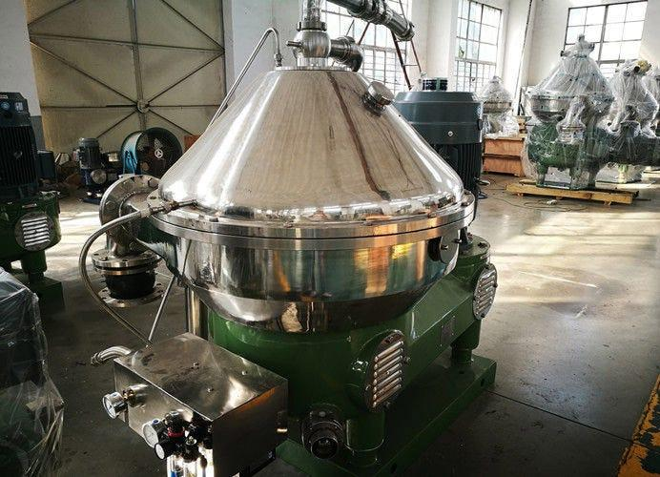
Presentation Outline
Introduction to centrifugation/sedimentation
Theory and mechanics of centrifugation
Theory and mechanics of sedimentation
Ammonia applications
Ammonia production applications
Conclusions and works cited
Medium. (2018, September 23). Centrifuge for food industry. Medium. https://medium.com/@chinacentrifuges/centrifuge-for-food-industry-57d7971a5054

Slide 3
Introduction
Centrifugation
A method of purification that utilizes centrifugal force to separate molecules by density
It has a wide range of applications spanning multiple Industries (pharmaceutical, nuclear, chemical, etc.,)
Sedimentation
Analyzes the intermolecular forces in a mixture to predict how molecules will settle out of solution and into layers (sediments)
Important in the analysis of centrifugation since materials commonly have different settling behaviours depending on the systems conditions

Slide 4
What is Centrifugation
Centrifugation is a technique used for the separation of particles from a solution according to their size, shape, density, viscosity of the medium and rotor speed.
Forces that impact centrifugation: rotational speed , density of sample and solution
F_{centrifuge} = F_{buoyancy} + F_{friction}
The particles move away from the axis when the centrifugal force exceeds the buoyancy and friction
The greater the difference in density, the greater the centrifuge force

Slide 5
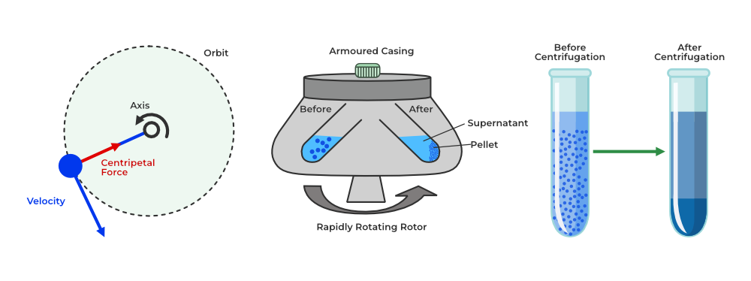
What is Centrifugation
https://www.fishersci.se/se/en/scientific-products/centrifuge-guide/centrifugation-theory.html

Slide 6
What is Sedimentation
Sedimentation: process of allowing particles in suspension in a liquid to settle out of the suspension under the effect of gravity
Stokes Law: Settling Velocity Equation
⍴_{P} = density of particle
⍴_{L} = density of liquid
𝛍 = viscosity of liquid
r = radius of particle
IWA Publications. (n.d.). https://www.iwapublishing.com/news/sedimentation-processes

Slide 7
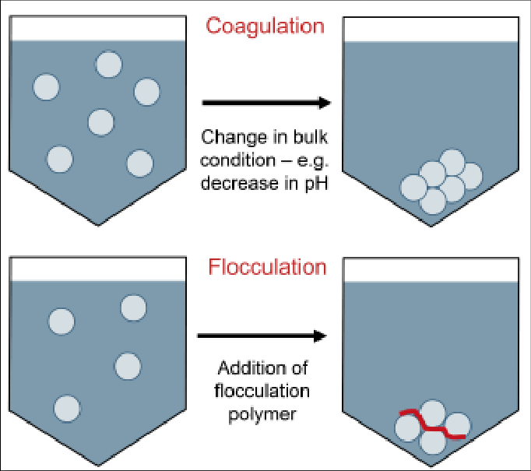
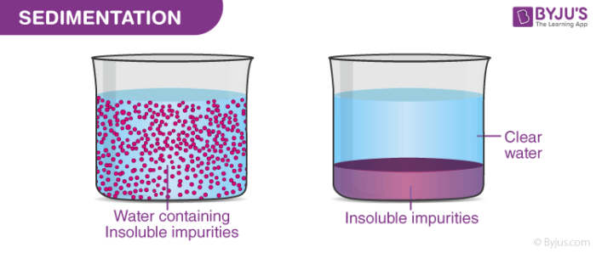
What is Sedimentation
Admin. (2022, August 3). Sedimentation & Examples: Centrifugation: Chemstry: Byju’s. BYJUS. https://byjus.com/chemistry/sedimentation/
Coagulation and flocculation [28]. | download scientific diagram. (n.d.). https://www.researchgate.net/figure/Coagulation-and-flocculation-28_fig2_351269364

Slide 8
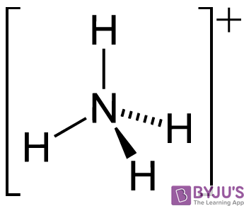
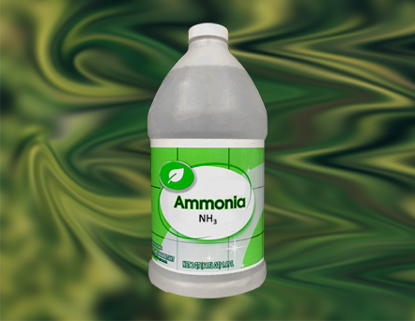
How is ammonia used in different applications
Refrigeration: ammonia is used as a refrigerant in industrial refrigeration systems
Fertilizers: ammonia is the key compound in the production of nitrogen based fertilizers like urea
Cleaning agents: ammonia is a powerful ingredient in a lot of cleaning products and detergents as it is effective in removing grease and stains
Heat treatment: Nitriding which involves involves the diffusion of nitrogen into the surface of metal components, improving their hardness and wear resistance.
https://www.blueland.com/articles/what-is-ammonia-and-how-does-it-impact-me#:~:text=Ammonia%20is%20primarily%20used%20in,from%205%2D10%25%20ammonia.
https://byjus.com/chemistry/uses-of-ammonia/#:~:text=Ammonia%20is%20used%20in%20wastewater,is%20also%20used%20in%20fermentation.

Slide 9
Cost of Ammonia vs Natural Gas

Slide 10
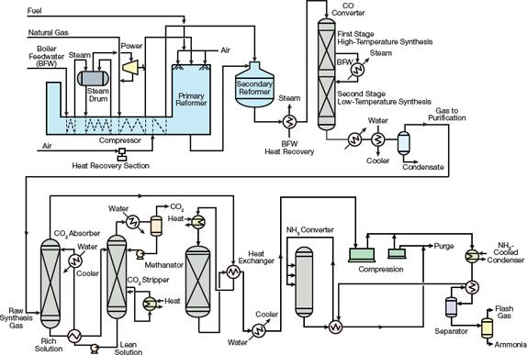
Ammonia Production Application
Kellogg Brown and Root Ammonia Plant
Four-case centrifugal compressor increased syngas to 153 bar and final operating pressure of 323 bar.
Optimized heat recovery and generated steam for steam turbines
https://www.aiche.org/resources/publications/cep/2016/september/introduction-ammonia-production

Slide 11
Works Cited
Medium. (2018, September 23). Centrifuge for food industry. Medium. https://medium.com/@chinacentrifuges/centrifuge-for-food-industry-57d7971a5054
Stokes law. Stokes Law - an overview | ScienceDirect Topics. (n.d.). https://www.sciencedirect.com/topics/engineering/stokes-law#:~:text=According%20to%20Stokes’%20law%2C%20the,the%20square%20of%20particle%20diameter.
IWA Publications. (n.d.). https://www.iwapublishing.com/news/sedimentation-processes
Admin. (2022, August 3). Sedimentation & Examples: Centrifugation: Chemistry: Byju’s. BYJUS. https://byjus.com/chemistry/sedimentation/
Coagulation and flocculation [28]. | download scientific diagram. (n.d.). https://www.researchgate.net/figure/Coagulation-and-flocculation-28_fig2_351269364

